Slide 1
Comprehensive Database System for Disease Data Management and Analysis
Presented By​:
Anuj
Niyanta
Dakshit

Slide 2

Introduction
Merged data management with healthcare to discover insights
Focused on extracting actionable insights from health data
Aimed to understand disease patterns, treatment efficacy, and patient demographics

Slide 3

Business Problem Definition
Focused on disease management and treatment optimization
Bridging the gap between data abundance and meaningful understanding
Empowering healthcare providers with critical insights for informed decisions

Slide 4
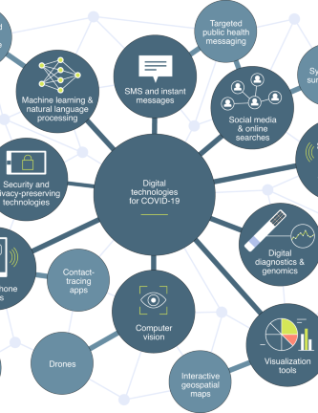
The Importance of Our Solution
Every data point represents a patient needing care
Our work extends beyond data: it could save lives
Blueprint for outbreak prediction, personalized treatments, and resource allocation
Potential impact on individual lives, healthcare systems, and global policies

Slide 5
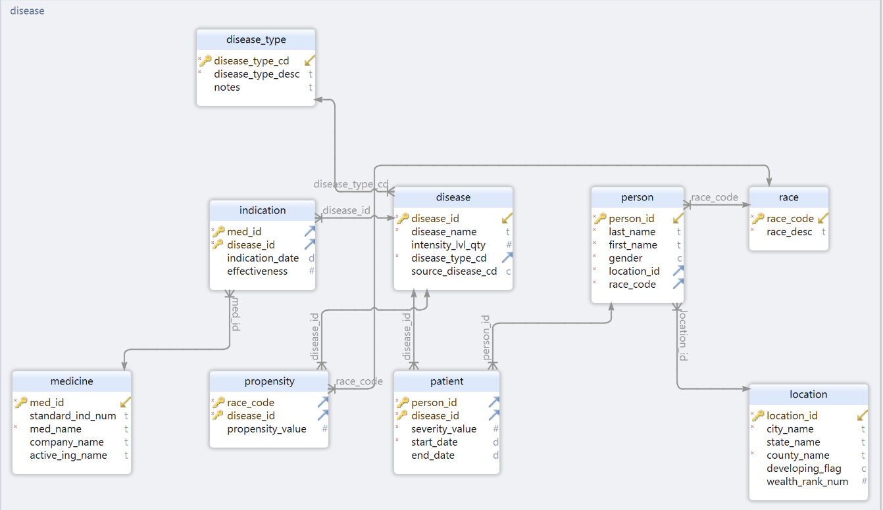
ER Diagram

Slide 6

Data Dictionary
Our data dictionary acts as a comprehensive glossary that defines every piece of data in our database. It is a key document that ensures everyone understands the data's meaning, importance, and interrelations. Let's take a look at a few entries
disease_type: This table holds information about the various categories of diseases
disease: This table captures the specifics of individual diseases
medicine: Here we store details on different medicines
indication: This table is about how medicines relate to diseases
Each table follows strict naming conventions for clarity and consistency

Slide 7
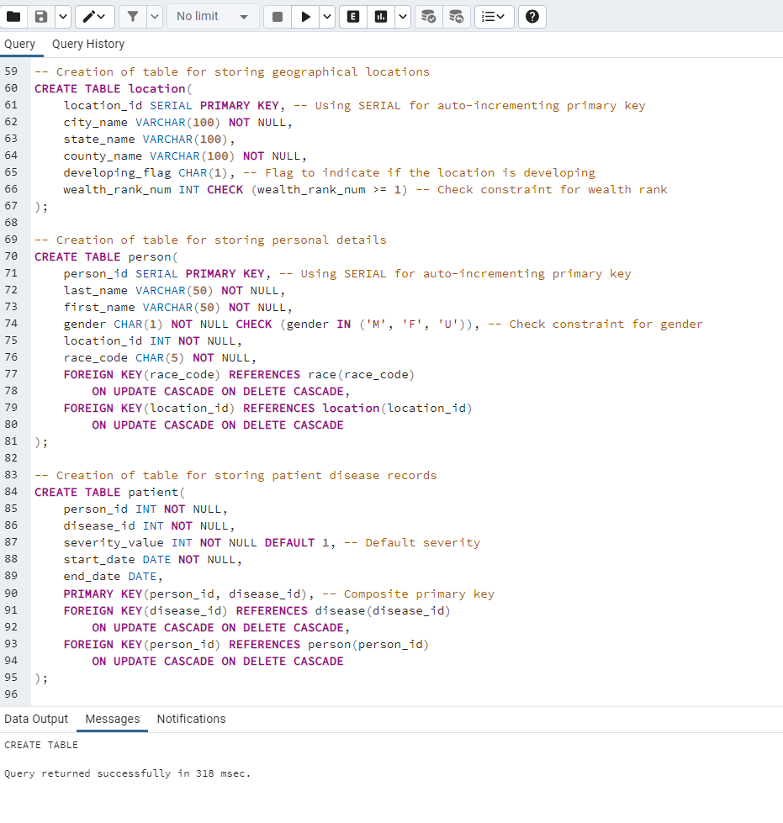
Database Implementation
Building and Populating Our Database
We started by defining the structure with SQL commands to create tables that mirror real-world entities and their complex interrelationships. Here's how we brought our database to life
Table Creation: We constructed a series of tables, each designed to capture a unique aspect of the healthcare data—from patient records to disease types, medicine details to indications
Data Loading: Rather than manual entry, we streamlined the process by loading pre-processed data from CSV files directly into the database, ensuring consistency and efficiency
Relationships and Integrity: We defined key relationships between our tables using foreign keys, with cascading updates and deletions to maintain data integrity

Slide 8
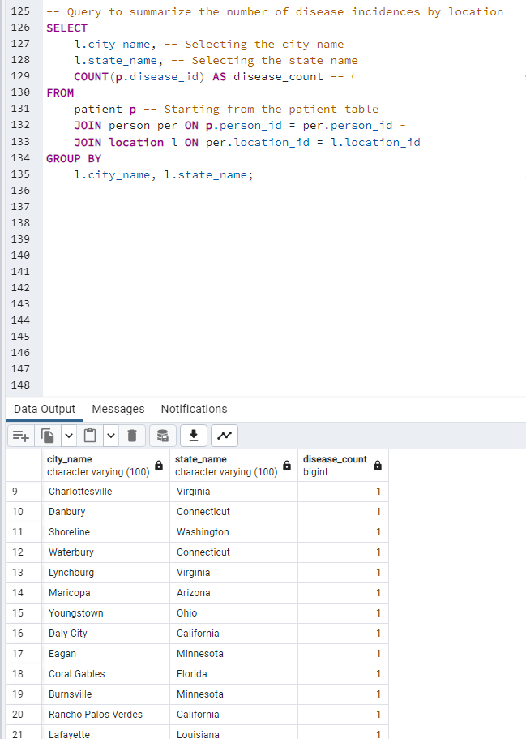
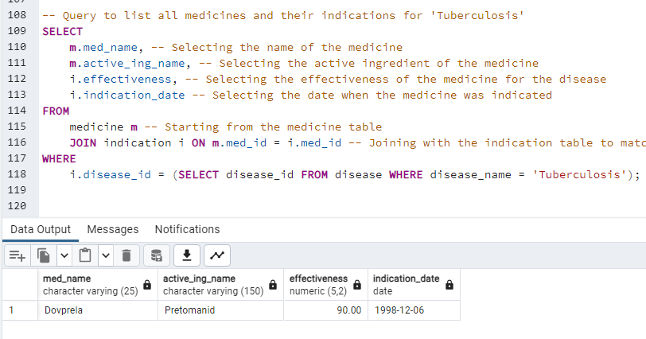
Operational Queries
Operational Queries against Postgres Loaded Database
Insightful Queries: Once our tables were populated, we unleashed the power of SQL to ask in-depth questions

Slide 9
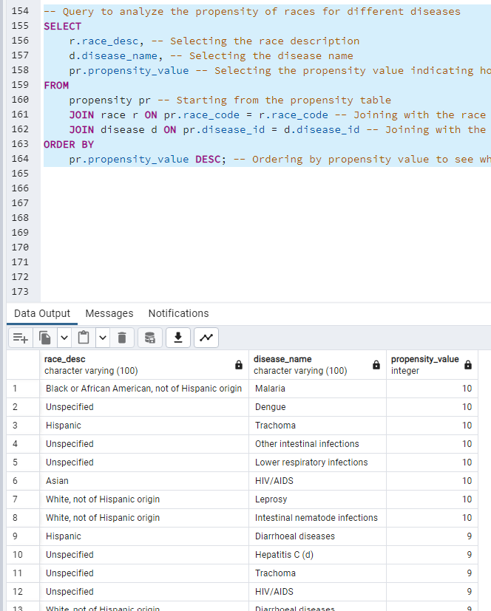
Operational Queries
Operational Queries against Postgres Loaded Database

Slide 10
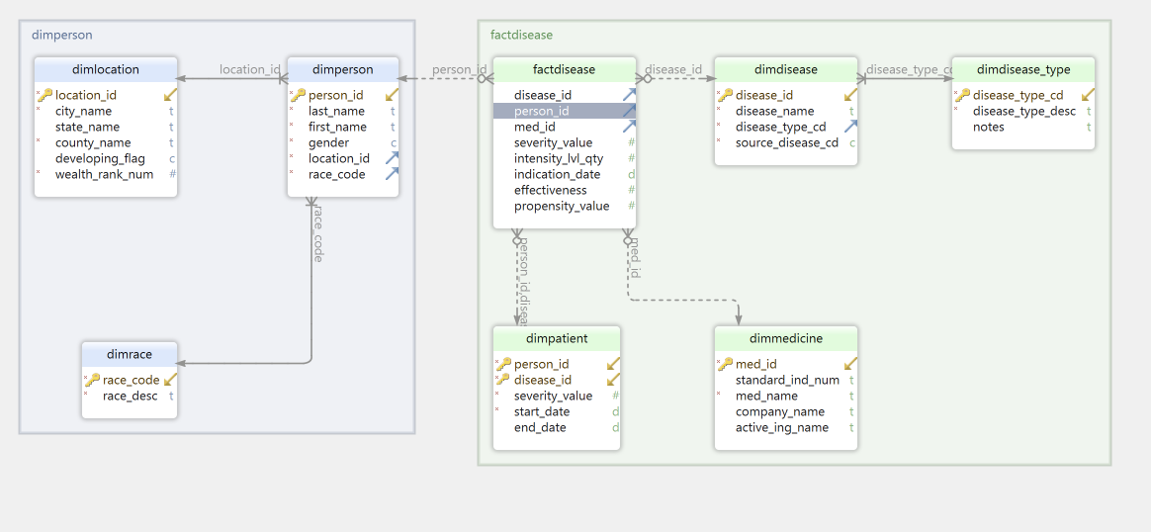
Building a Dimensional Framework for Analysis
To support advanced data analysis, we structured our data warehouse around a dimensional model.
This model is intuitive, mirroring how business users think about data.

Slide 11

OLAP Process
We created dedicated tables for each dimension—Disease Types, Diseases, Medicines, and more—each with unique identifiers and descriptive attributes. ​
Our fact table, factDisease, sits at the core, recording the intersections of these dimensions, like which patients have which diseases and how they're being treated.

Slide 12
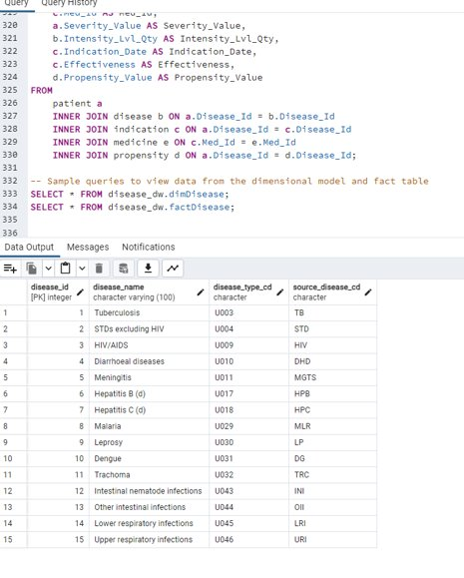
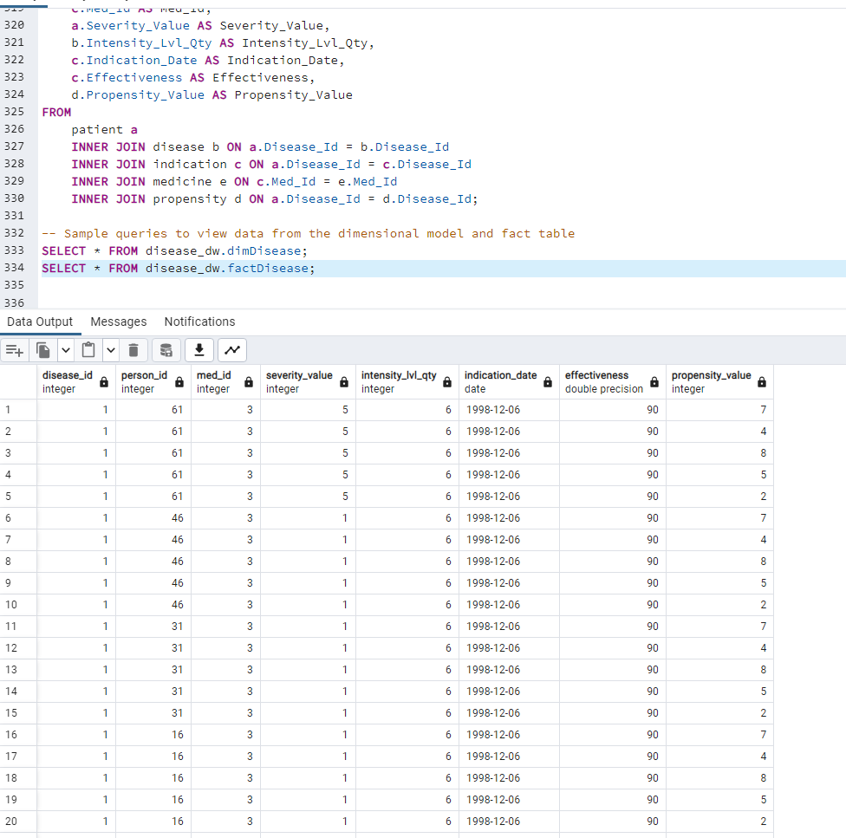

Slide 13
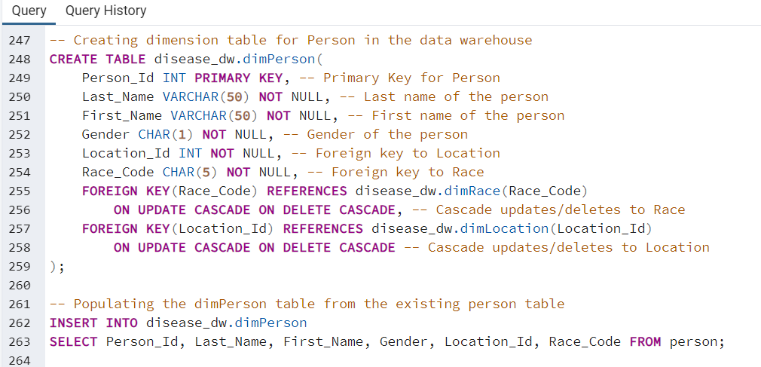
ETL Process - From Raw Data to Analytical Readiness
Transforming Data into Insights
Our ETL process is the pipeline that channels data from operational systems into our data warehouse. Here's how we made it happen
Extraction: We pulled data out from various sources, including our primary OLTP system
Transformation: We performed necessary data transformations, like converting gender codes to a standardized format and calculating intensity levels for diseases
Loading: Using CSV files, we efficiently imported the transformed data into our data warehouse schema, disease_dw

Slide 14
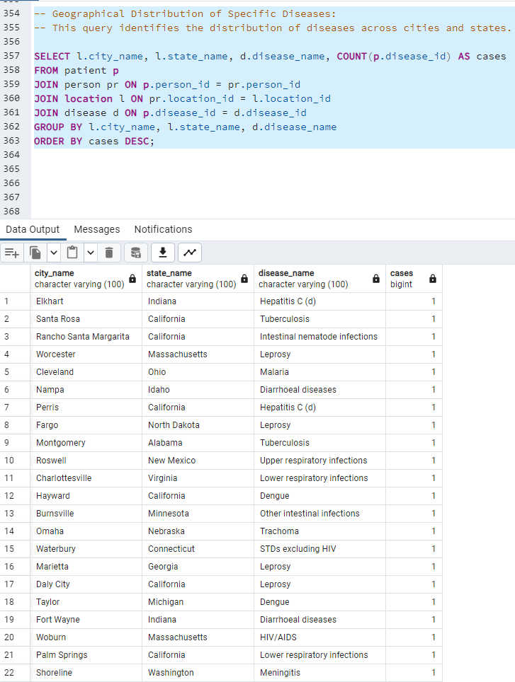
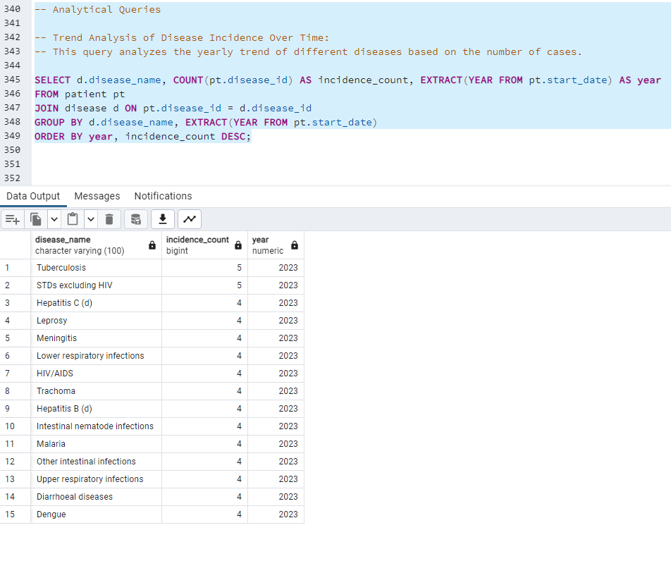
Analytical Queries
Gaining Insights with Targeted Queries
Harnessing data power by asking targeted questions
Examined disease patterns over time to identify trends
Mapped diseases geographically to pinpoint hotspots

Slide 15
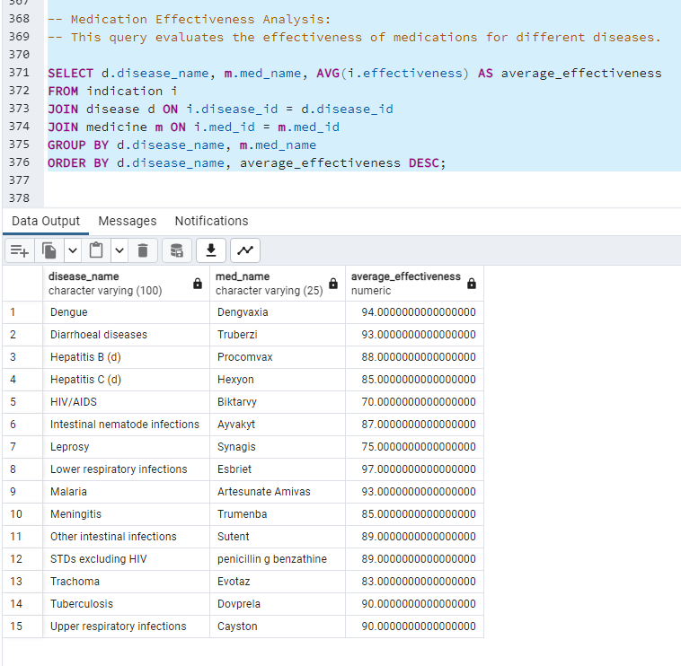
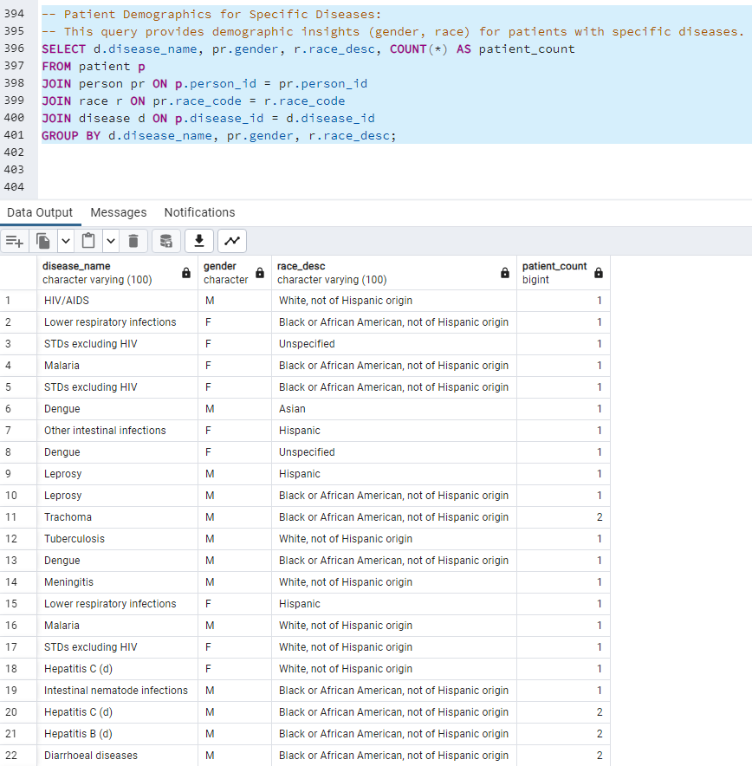
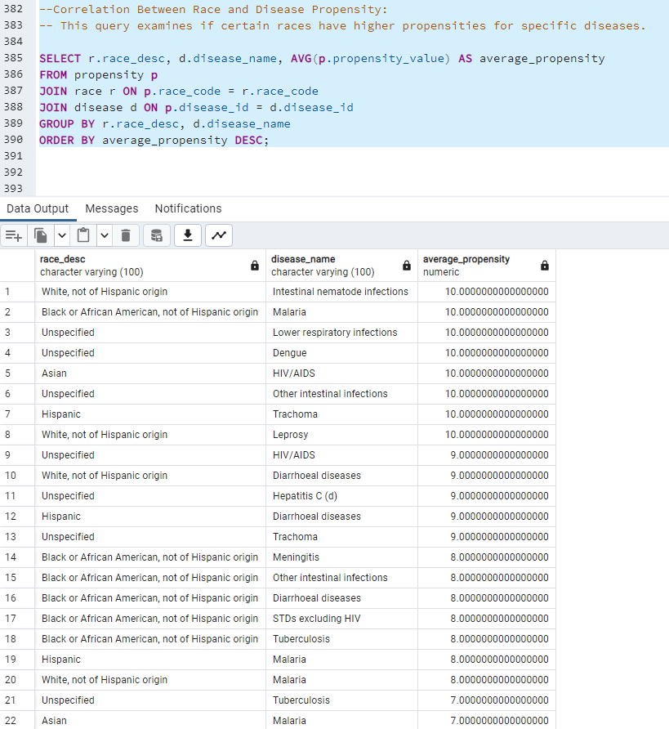
Analytical Queries
Gaining Insights with Targeted Queries
Assessed treatment effectiveness to find the best options
Analyzed disease impact on different demographics for tailored healthcare
Transformed data into actionable insights for informed healthcare planning

Slide 16
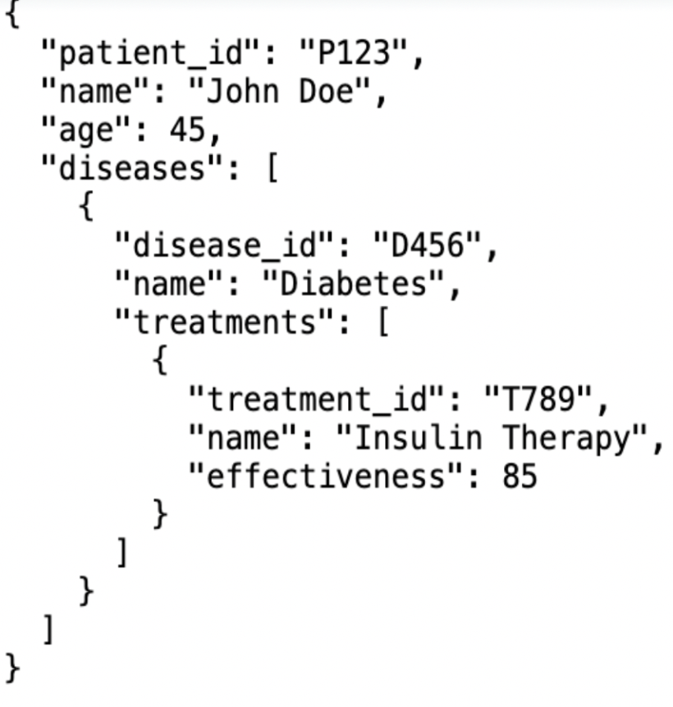
MongoDB- Document Oriented NoSQL DB
Documents and Collections: Each document can have a varied structure, containing all the data related to a single entity, which allows embedding arrays and other documents directly.
Denormalization: Related data might be stored together in the same document for quicker read access, reducing the need for joins
Schema-less Design: The schema can evolve over time without requiring migrations, making it easier to adapt to changing data needs.

Slide 17
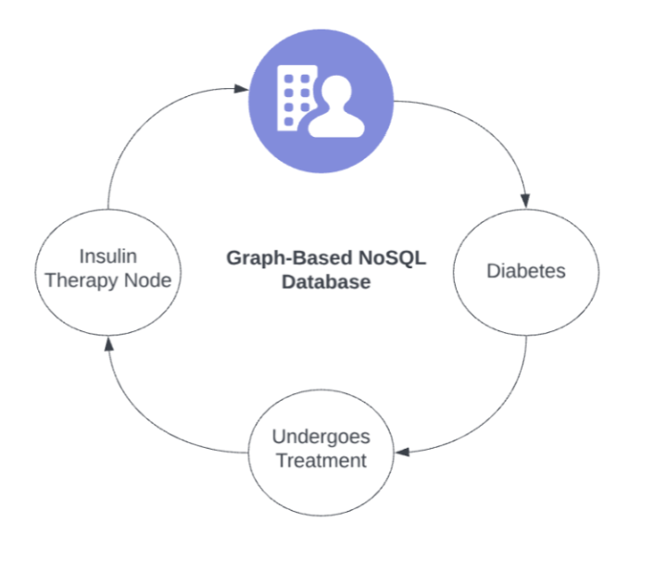
Neo4j Graph Based NoSQL DB
Nodes and Relationships: Data is structured as nodes (entities) and edges (relationships), which is ideal for datasets where relationships are as important as the data itself.
Property Graph: Both nodes and relationships can have properties, allowing them to store data.
Schema-free: There's no fixed schema, enabling you to add different properties to nodes and relationships as needed.

Slide 18
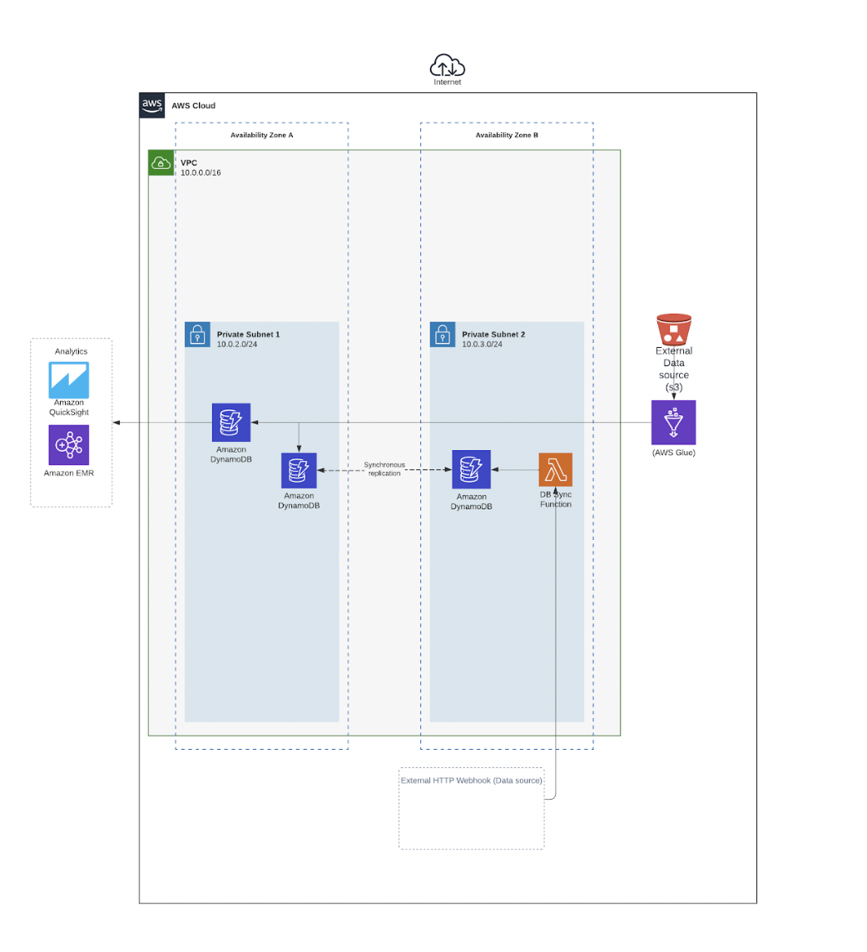
Components of AWS Architecture
Amazon EC2: Host application in the cloud.
Amazon S3: Store backups, logs, and other files.
AWS Glue: For ETL process
AWS DynamoDB: As NoSQL databases for different types of data storage needs.
AWS Lambda: To run code in response to triggers (such as changes in data or system states).
Amazon EMR on AWS: To handle data-processing jobs

Slide 19
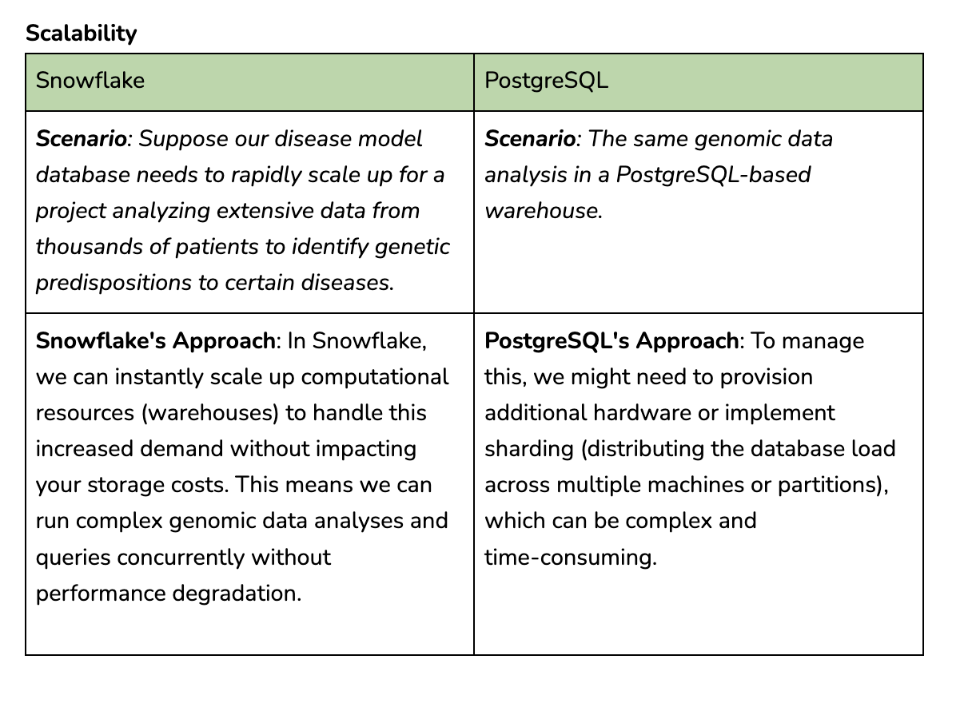

Slide 20
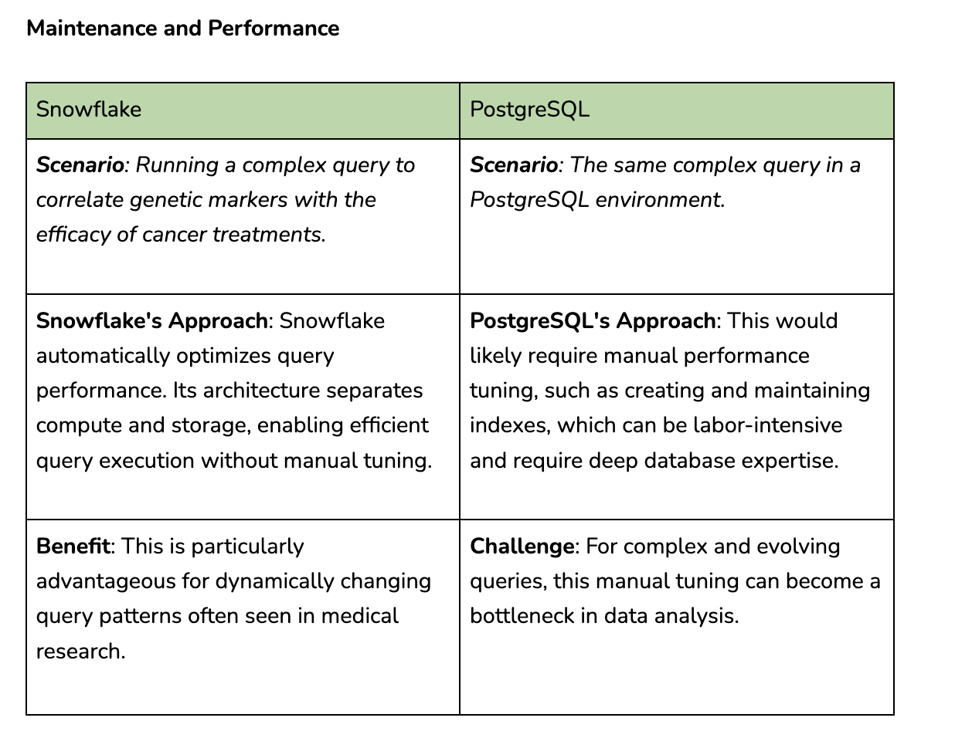

Slide 21
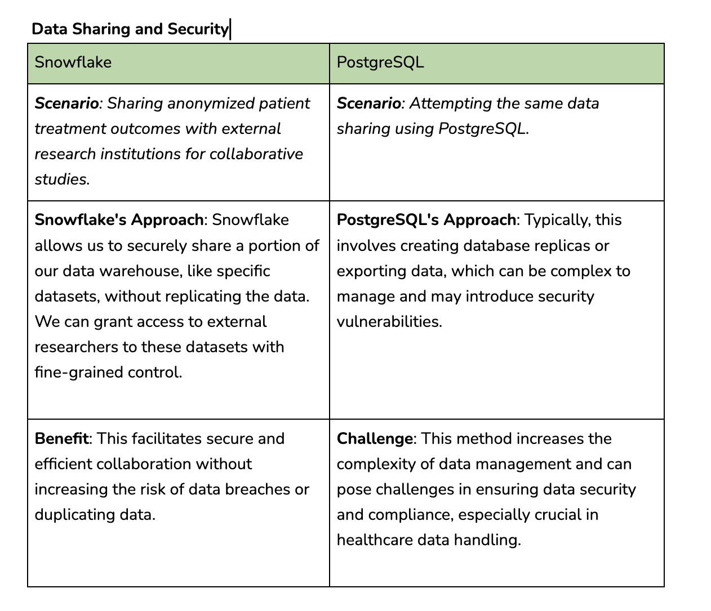

Slide 22

Project Conclusion - Key Takeaways
Built a robust disease data model for in-depth analysis and insights
Explored NoSQL databases for flexible, schema-less data structuring
Utilized Snowflake to experience the benefits of cloud data warehousing
Implemented AWS for scalable, real-time, and batch data processing
Met project goals, demonstrating a scalable solution for healthcare analytics
Set the stage for future innovations in health data management and analysis

Slide 23

Any Questions?

